Slide 1
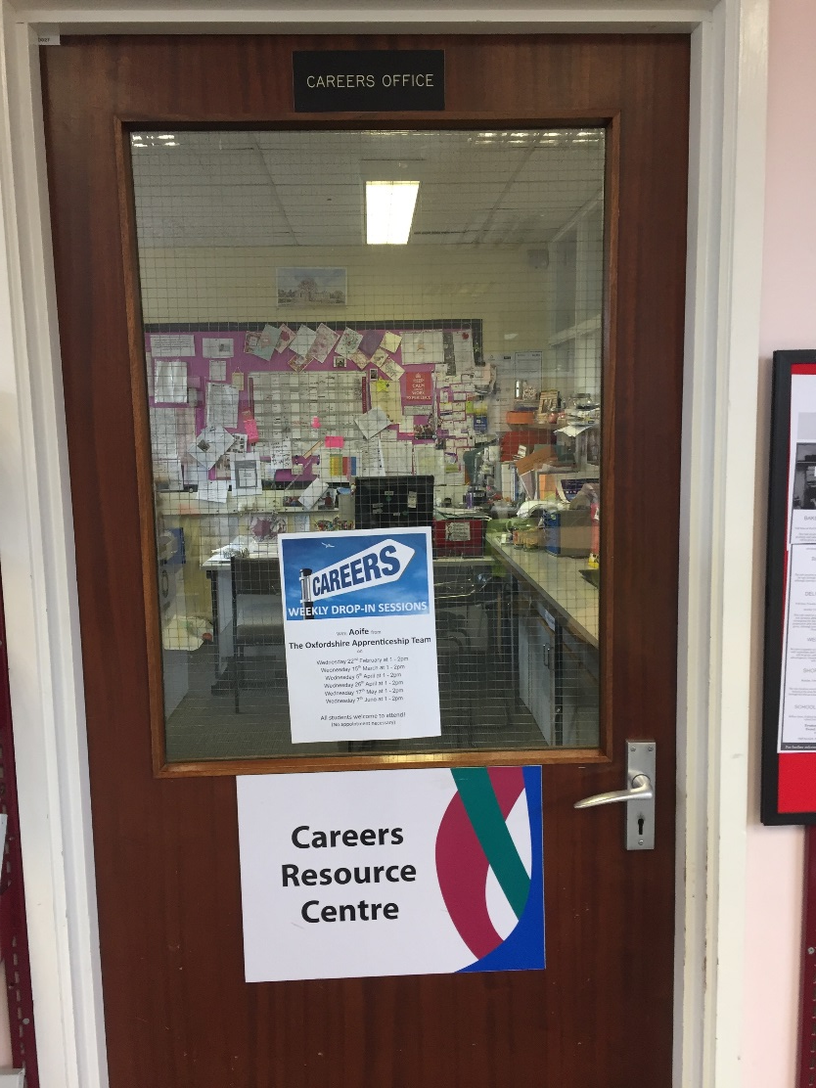
Welcome to the Careers Resource Centre at Larkmead School

Slide 2
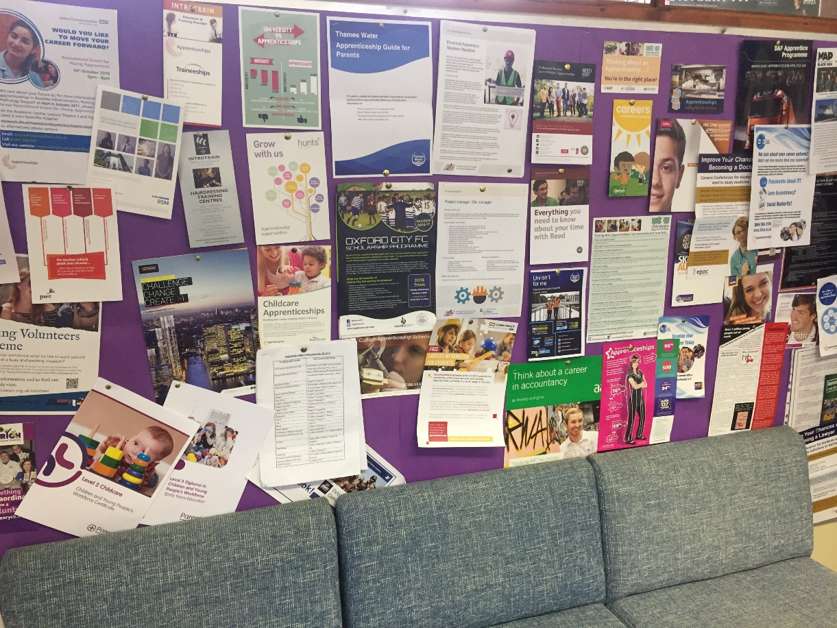
What is the CRC (Careers Resource Centre?)
The CRC is the place you can come to for support and guidance on:
Careers
Work experience
Enterprise activities
You’ll find a warm welcome from Mrs Christiansen who is on hand to help support you with your enquiries
We have a wide range of resources available for you to access .

Slide 3
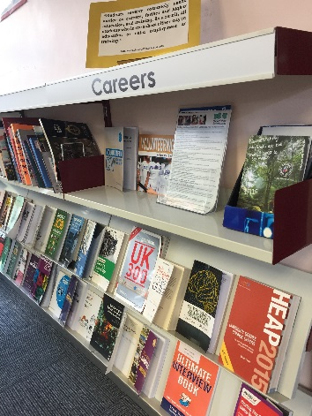
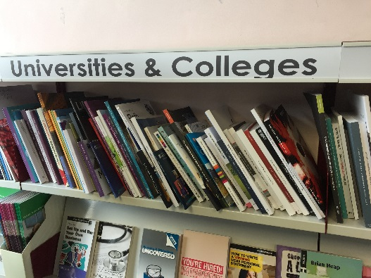
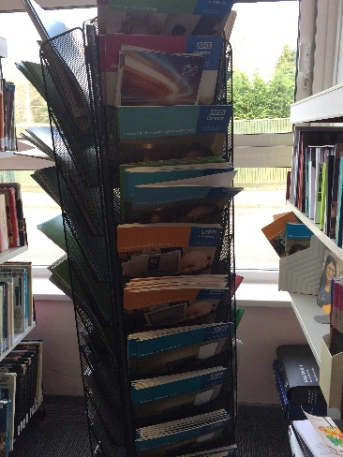
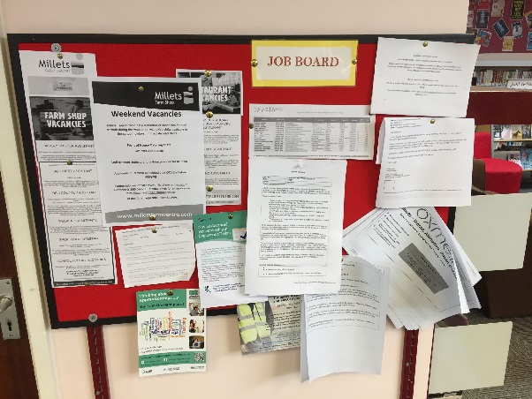
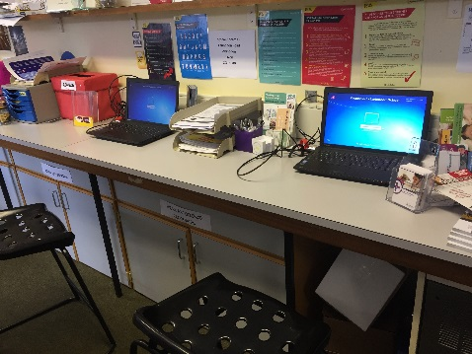
What’s on offer?
Daily drop in sessions with Mrs Christiansen
Access to an independent impartial careers adviser
Regular lunch time sessions with visiting advisers
Access to the careers library
Access to HE/ FE prospectuses
Access to current brochures and leaflets
Information on open days
Jobs Board
Access to laptops
Special Events!

Slide 4
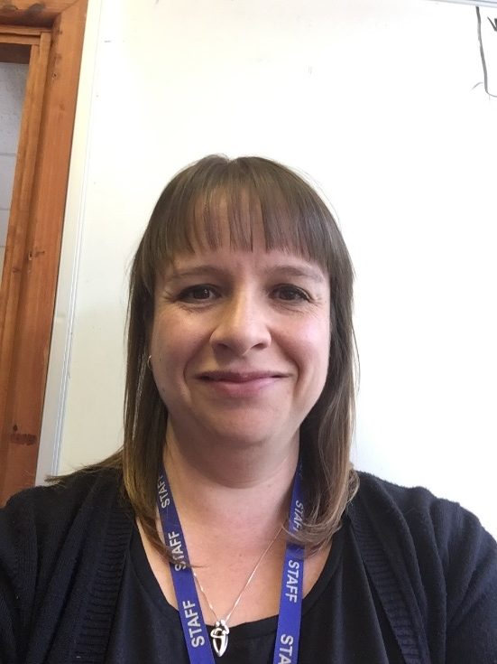
Daily drop in sessions with Mrs Christiansen
Mrs Christiansen runs daily drop in sessions for all students every break time and lunch time & after school on Wednesday / Thursday
6th formers are welcome to call in when they have a free lesson or during complementary studies.
Appointments during pm registration or lessons can be made to discuss work experience or options.
E-support is available, please e-mail c.Christiansen@Larkmead.oxon.sch.uk and Mrs Christiansen will usually get back to you within 2 working days

Slide 5
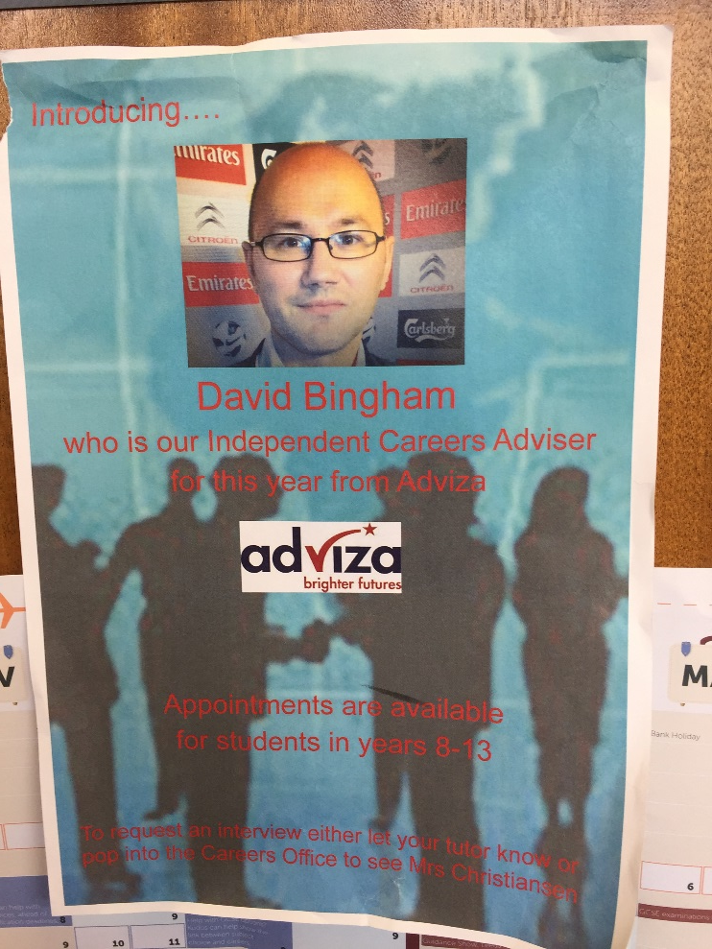
Access to an independent impartial careers adviser
Larkmead school is committed to providing students with independent, impartial Careers Advice and guidance, in order to this we contract Adviser to provide us with a Careers Adviser.
Our current representative from Adviza is David Bingham
All students from years 8-13 can request an appointment via your tutor or through Mrs Christiansen
Adviza are here every term, with more appointments during terms 2,3&4.
Students in year 11 will get allocated an appointment depending on where they are hoping to go post year 11.
Parents are welcome to join students for their appointment

Slide 6
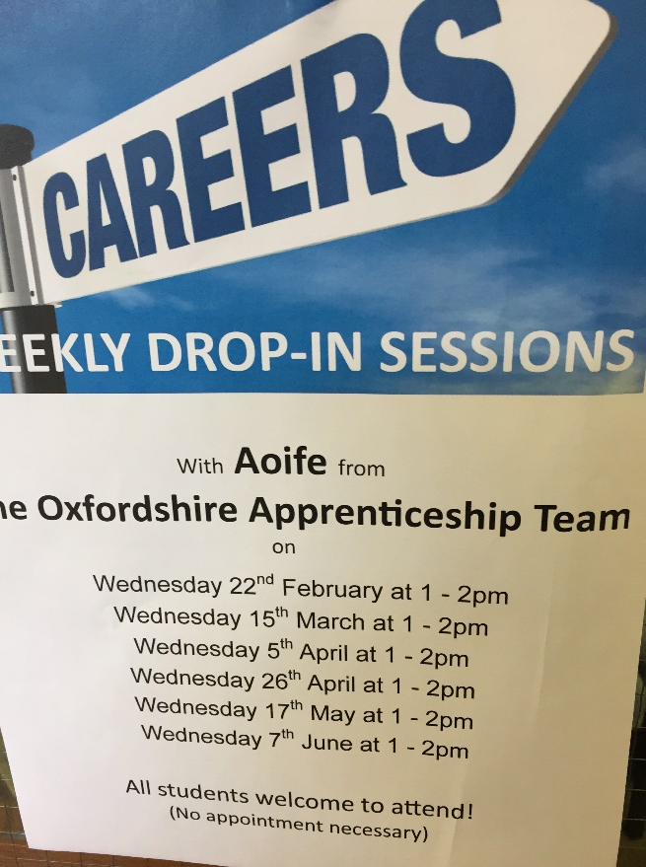
Regular lunch time sessions with visiting advisers
During the course of the school year we regularly invite professionals in to run a drop info session during lunch time. In the past these have included –
Aoife from Oxfordshire Apprenticeship Team
Marija from Abingdon and Witney College
Natalie from Activate Learning Oxford
Claire from Parenta
Charlie and Sam from National Grid
Georgie from Microsoft
Lisa from Ace training
Rachel from NCS
Caroline from Introtrain
Air cadets
Oxfordshire soccer school

